Slide 1
Морфологические и физиологические принципы взаимодействия между нейронами и астроцитами
24 апреля 2015 г. «НЕЙРОНАУКИ И НЕЙРОТЕХНОЛОГИИ»
Семьянов Алексей Васильевич
Институт Биологии и Биомедицины ННГУ им. Лобачевского, г. Нижний Новгород.

Slide 2
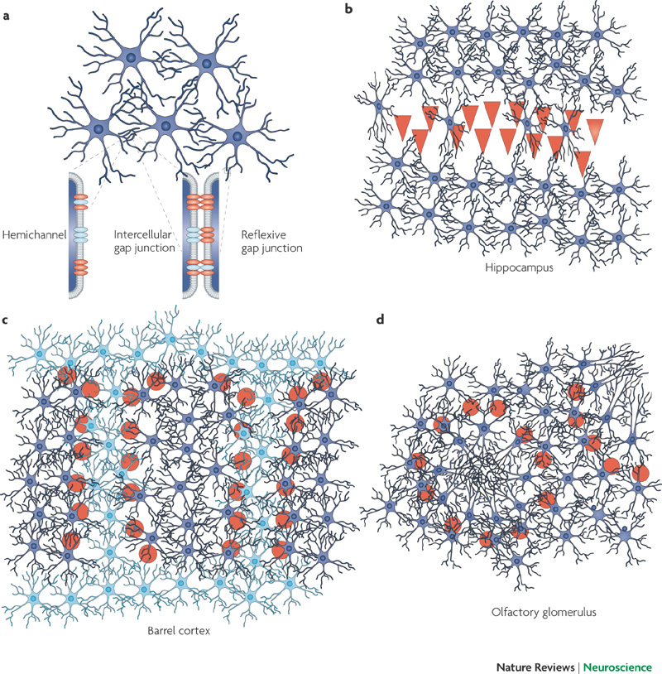
Neuronal and glial networks in the brain
Giaume et al. 2010

Slide 3
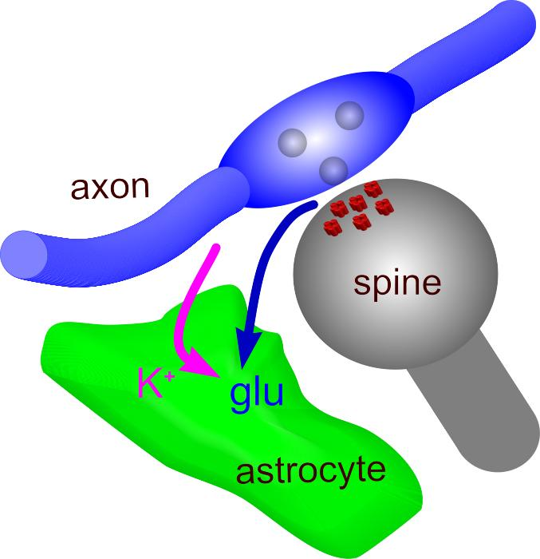
Astrocytes maintain synaptic homeostasis

Slide 4
Astrocyte is required for synaptic plasticity
Henneberger et al 2013

Slide 5
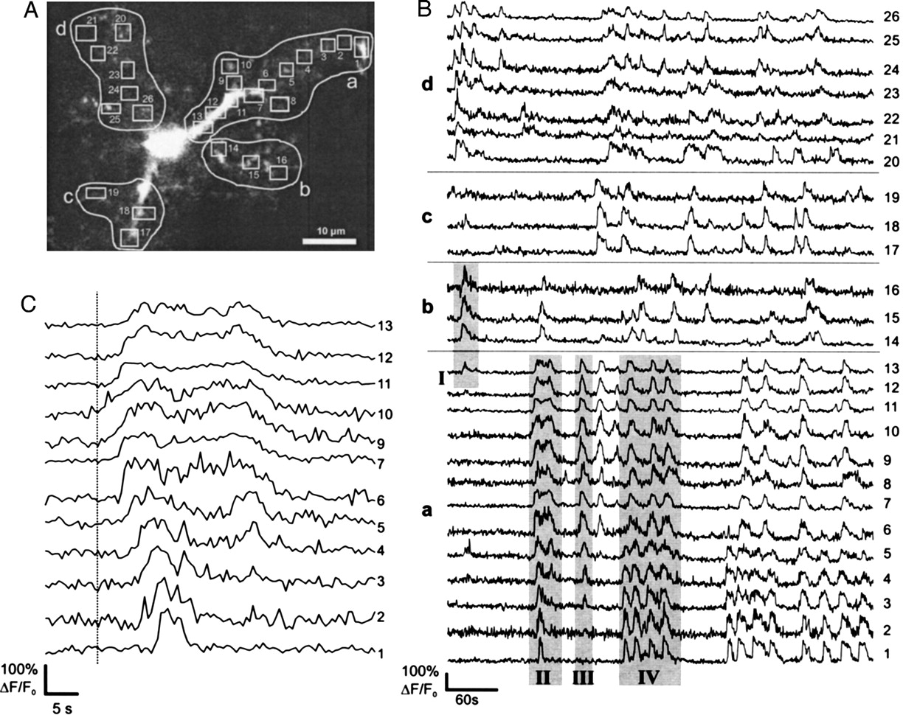
Ca²⁺ events occur independently in astrocytic compartments
Nett et al 2001

Slide 6
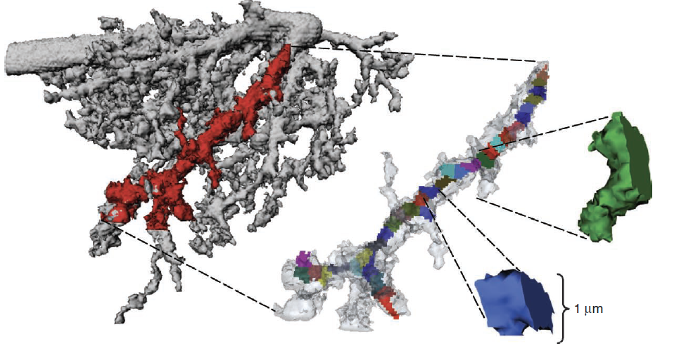
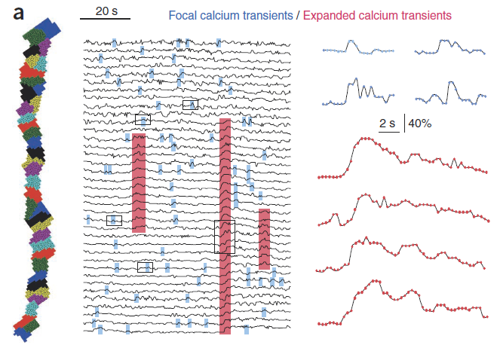
Two-photon imaging of Ca²⁺ activity in astrocytic processes
Di CAstro et al. 2011

Slide 7
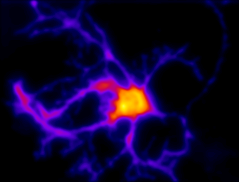
Integrative functions of neurons and astrocytes
vs
20 µm

Slide 8
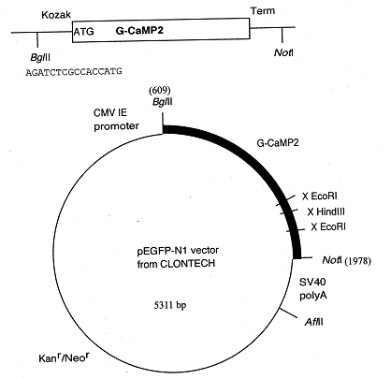
Astrocytes transfected with Ca²⁺ sensor GCaMP2
20 µm
Tallini et al 2006;

Slide 9
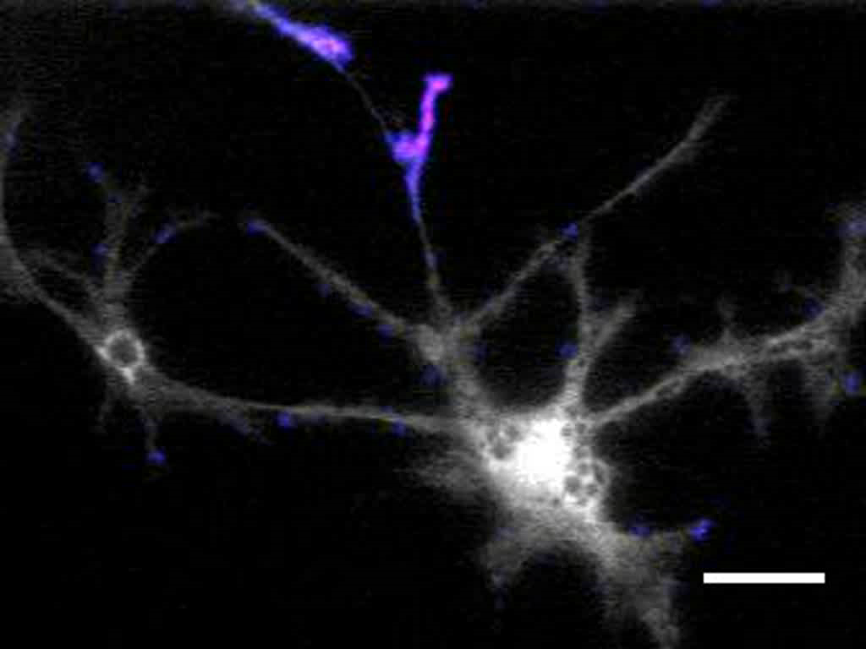
Dynamics of Ca²⁺ activity in cultured astrocyte
10x movies: fluorescence and ΔF/F

Slide 10
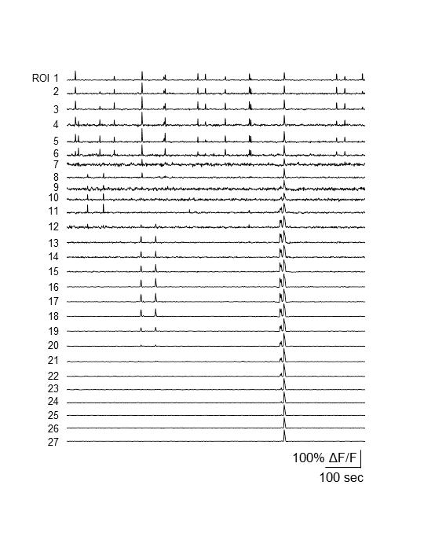
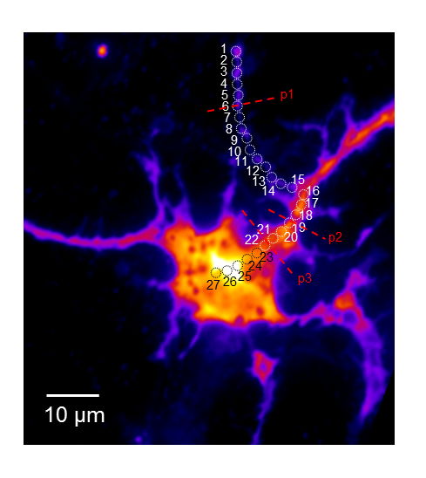
Focal and expanded Ca²⁺ events

Slide 11
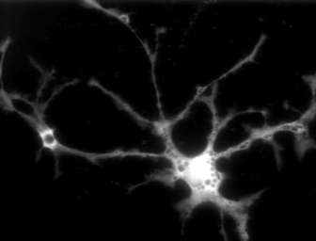




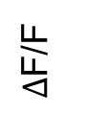
Whole event based analysis
$Δ$F/F
0
0.5
1
1.5
2
2.5
3
3.5
4
4.5
Time (s)
20 µm
1. Duration
Binary
2. Maximum projection (S_{max})
0.8
Time-axis
Y
0.4
X
0 ΔF/F
Notes:
Methods for new analysis

Slide 12
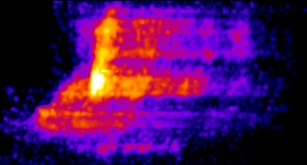





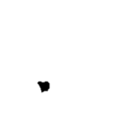
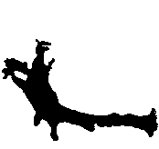


Whole event based analysis
10 μm
2 sec
10 μm
S_{init}
S_{max}
S_{init}
S_{max}
10 μm
10 μm
2 sec
10 μm
S_{init}
S_{max}
10 μm
2 sec
10 μm
S_{init}
S_{max}
10 μm
10 μm
Notes:
Methods for new analysis

Slide 13
Distributions of S_{max} and durations follow power-law
10⁻⁰
10⁻¹
10⁻⁰
10⁻²
10⁻¹
10⁻³
10⁻²
Probability density
Probability density
10⁻⁴
10⁻³
10⁻⁵
10⁻⁴
10⁻⁶
10⁻⁷
10⁻⁵
10⁻⁸
10⁻⁶
1
10
100
1
10
100
1,000
10,000
S_{max} (μm²)
Duration (s)

Slide 14
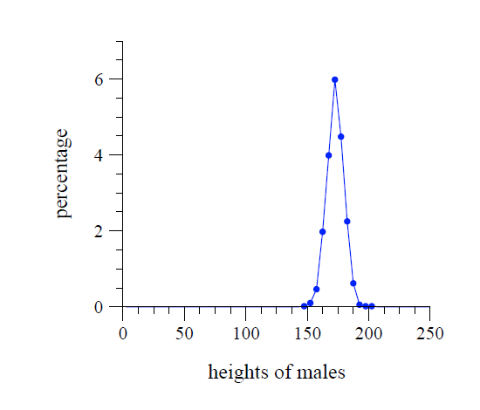
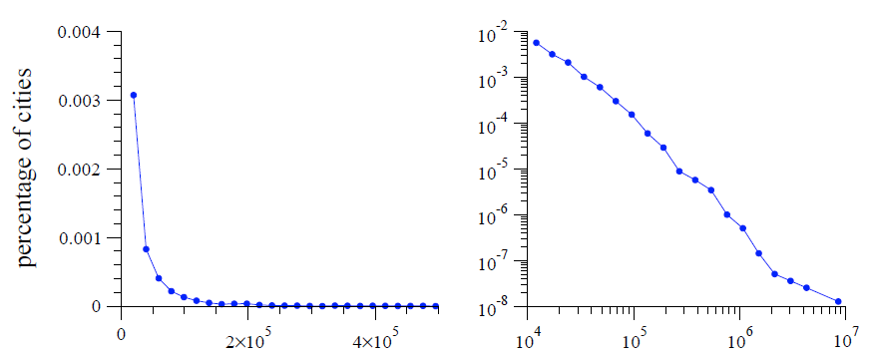
Normal and power-law distributions
population of city
Newman, M. E. J. (2005)

Slide 15
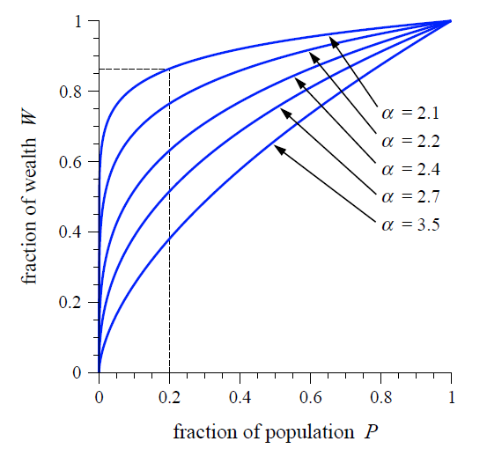
Pareto principle
20-80 rule
Newman, M. E. J. (2005)

Slide 16
‘Pareto principle’ for astrocyte
30-70 rule
1
0.8
0.6
S_{max} or duration
0.4
0.2
S_{max}
Duration
0
0.2
0.4
0.6
0.8
1
Fraction of distribution

Slide 17
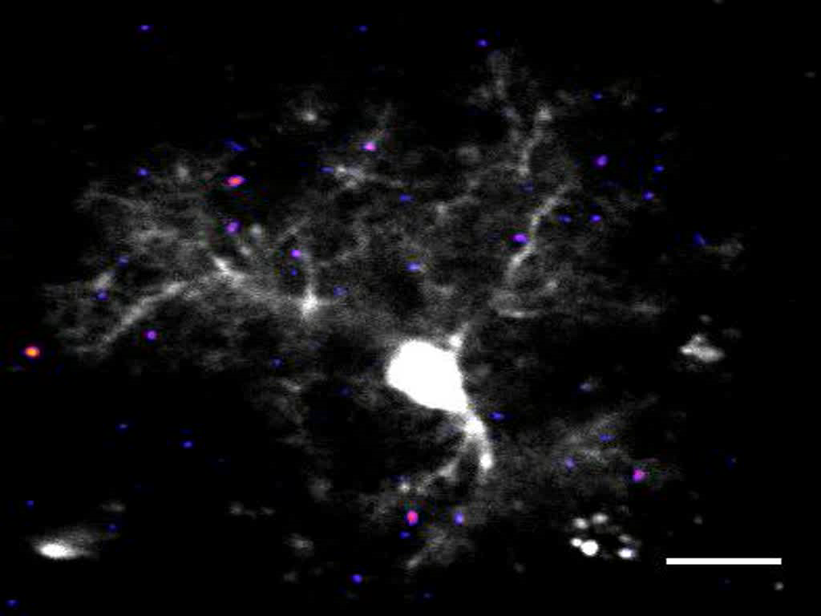
Spatiotemporal Ca²⁺ dynamics in hippocampal slices
10x movies: fluorescence and ΔF/F

Slide 18
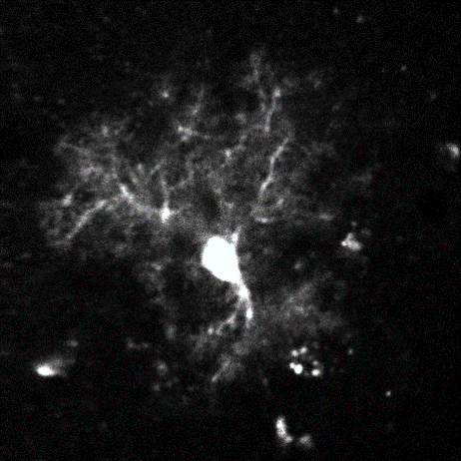

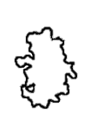


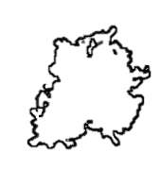
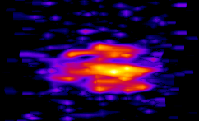
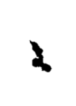
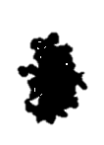

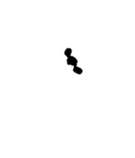

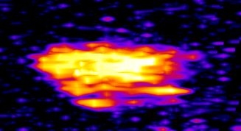
Spatiotemporal Ca²⁺ dynamics in hippocampal slices
2
1
S_{init}
S_{max}
3
5 μm
1 sec
5 μm
5 μm
2
S_{init}
S_{max}
1
10 µm
5 μm
1 sec
5 μm
5 μm
20 µm
3
S_{init}
S_{max}
5 μm
5 μm
1 sec
5 μm

Slide 19
Spatiotemporal Ca²⁺ dynamics in hippocampal slices
10⁻⁰
10⁻¹
10⁻⁰
10⁻²
10⁻¹
10⁻³
Probability density
Probability density
10⁻²
10⁻⁴
10⁻⁵
10⁻³
10⁻⁶
10⁻⁴
1
10
100
1,000
1
10
100
S_{max} (μm²)
Duration (s)

Slide 20
Astrocytic Ca²⁺ dynamics principle
Sizes and durations of Ca²⁺ events follow power law distribution
1.1. No event subclasses
1.2 30% ‘Ca²⁺ rich’ events
contribute 70% of total Ca²⁺
Activity dependent mGluRs activation changes the power law exponent
10⁰
10⁶
Change in the slope (α )
10⁻²
10⁴
Pr(S_{max} )
N(S_{max} )
10⁻⁴
|Slope| =
10²
10⁻⁶
10⁰
10
100
1,000
10,000
10
100
1,000
10,000
S_{max} (μm²)
S_{max} (μm²)

Slide 21
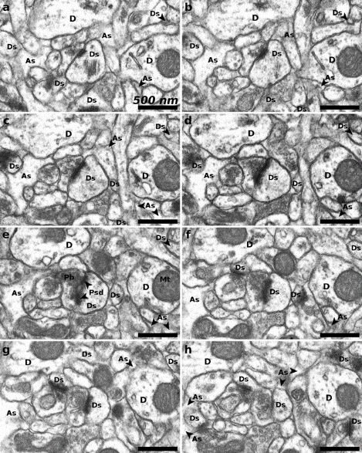
Serial EM sections of hippocampal neuropil

Slide 22
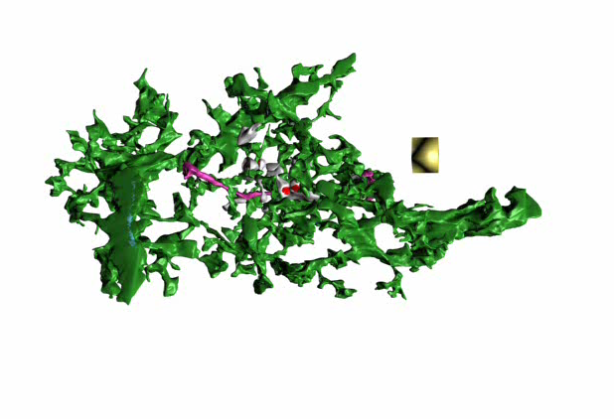
3D reconstruction of astrocyte
Patrushev et al., Cell Calcium 2013

Slide 23
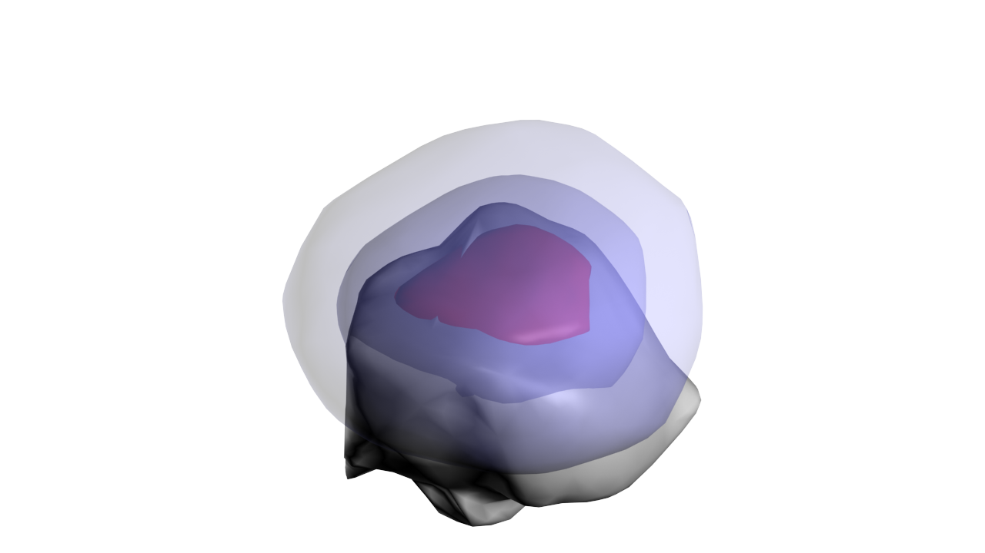
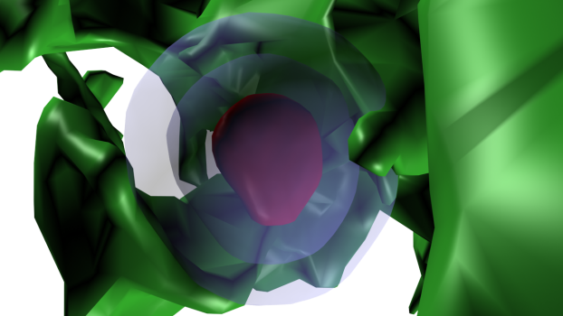
Properties of perisynaptic astrocytic processes
Patrushev et al., Cell Calcium 2013

Slide 24
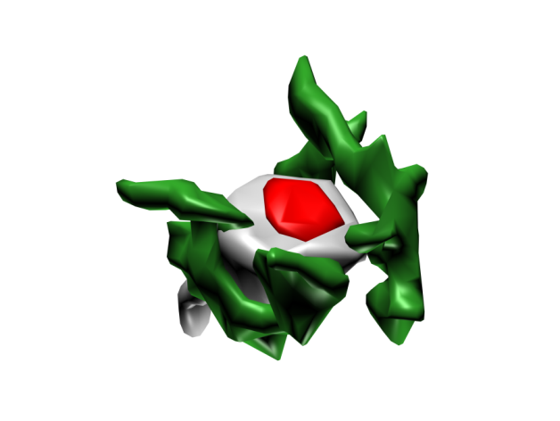
Astrocyte volume fraction increases with distance from PSD
Astrocyte VF
Distance from PSD (nm)
Patrushev et al., Cell Calcium 2013

Slide 25
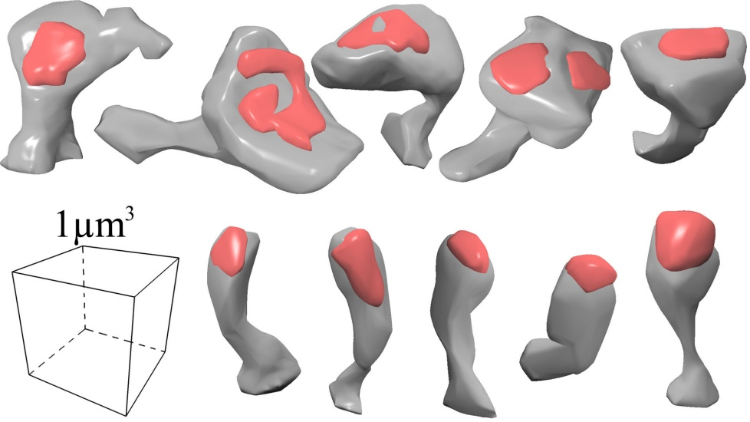
Astrocyte volume fraction depends on spine type
mushroom
spines
thin
spines
thin
spines
mushroom
spines
Count
Astrocyte VF
Spine radius (µm)
Distance from PSD (nm)
Patrushev et al., Cell Calcium 2013

Slide 26
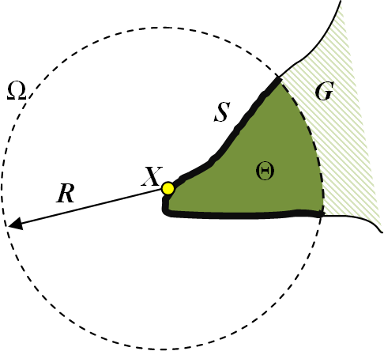
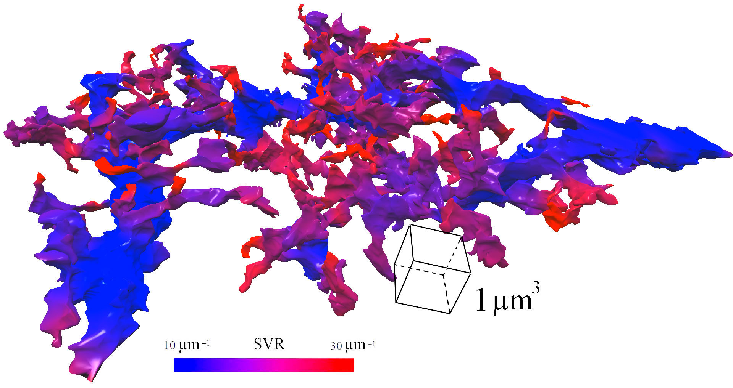
Quantification of astrocyte surface-to-volume ratio
Patrushev et al., Cell Calcium 2013

Slide 27
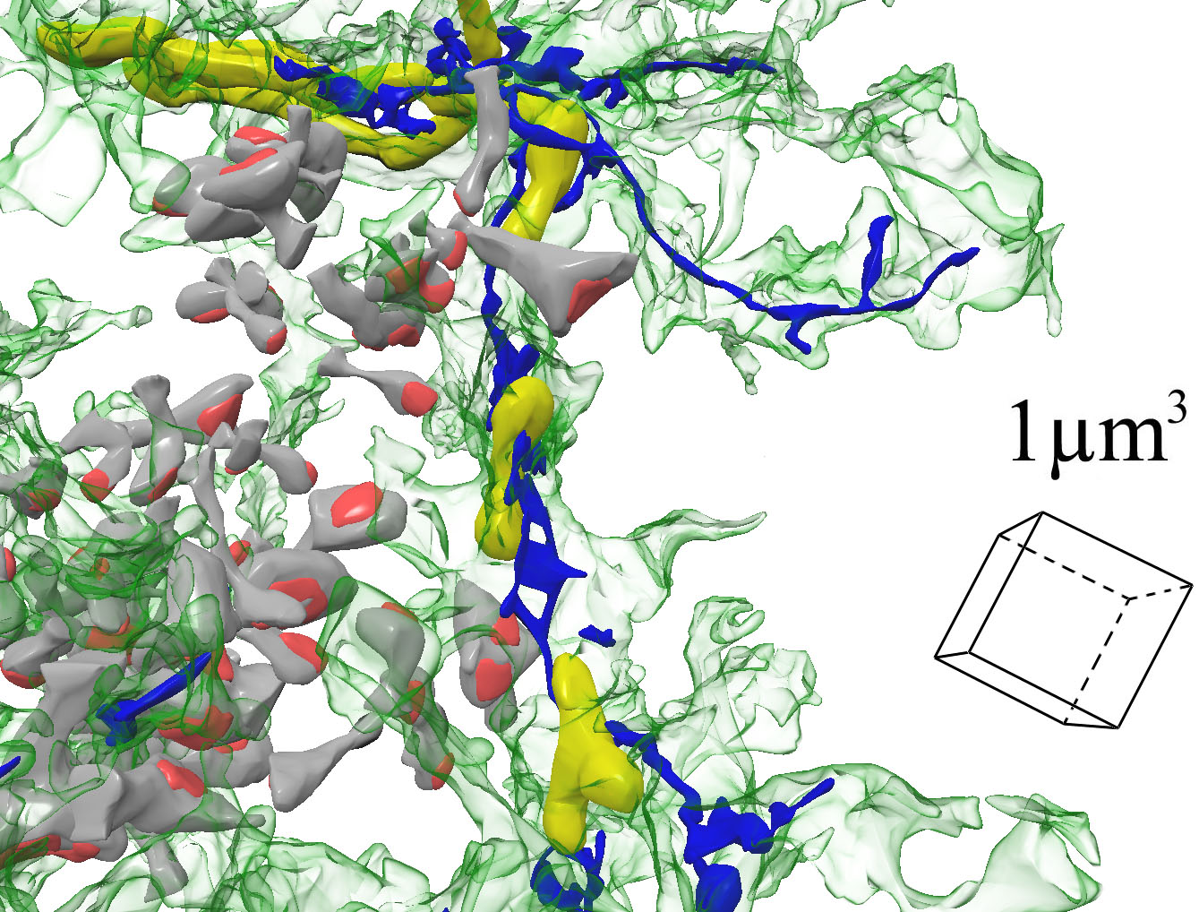
Distribution of Ca²⁺ stores in astrocytes
Ca²⁺ stores fraction
of astrocyte volume
Astrocyte SVR (µm⁻¹)
Patrushev et al., Cell Calcium 2013

Slide 28
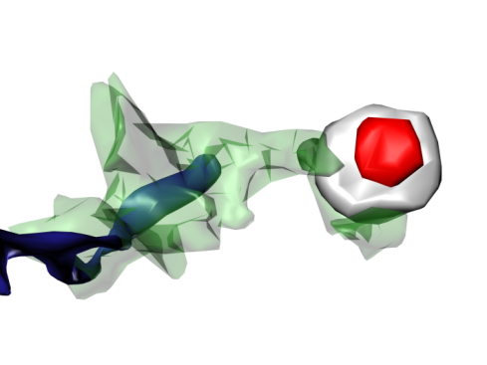
Perisynaptic astrocytic processes lack Ca²⁺ stores
Astrocyte VF
Ca²⁺ stores fraction
of astrocyte volume
Distance from PSD (nm)
Patrushev et al., Cell Calcium 2013

Slide 29
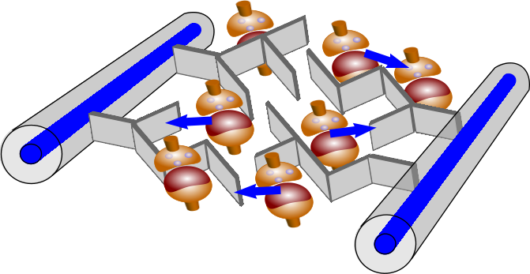
Neuronal network – astrocyte communication

Slide 30
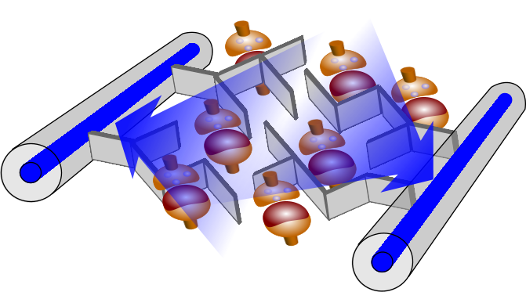
Neuronal network – astrocyte communication

Slide 31
Acknowledgements
Niznhy Novgorod University
Victor Kazantsev
Yulia Dembitskaya
Nikolay Gavrilov
Vadim Turlapov
Institute of Cell Biophysics, Puschino
Ilya Patrushev
Victor Popov
RIKEN Brain Science Institute
Xiaofang Tang
Yu-Wei Wu
Pei-Yu Shih
Katsuhiko Mikoshiba
Hiroko Bannai
Misa Arizono
Shigeyoshi Itohara
Mika Tanaka

Slide 32
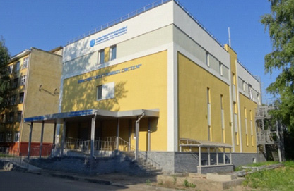
Нижегородский Нейронаучный Центр

